Slide 1
VBA Workspace – a walkthrough
Version: 05-Apr-2018

Slide 2
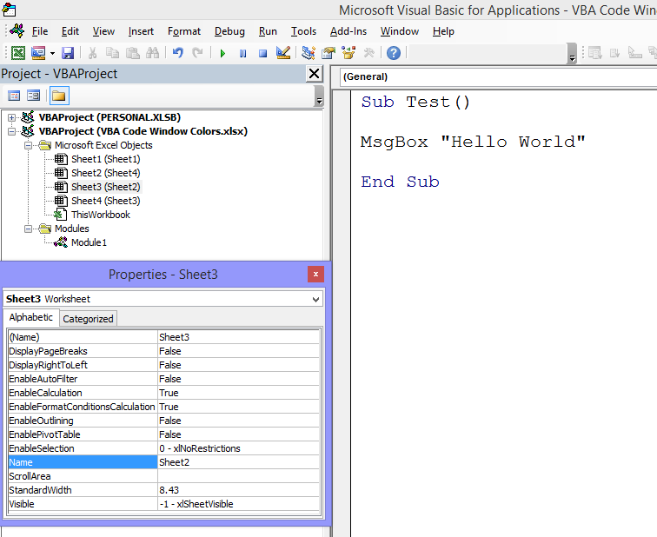
PROJECT EXPLORER
PROPERTIES WINDOW
CODE WINDOW

Slide 3
CODE WINDOW

Slide 4
PROJECT EXPLORER

Slide 5
PROPERTIES WINDOW

Slide 6
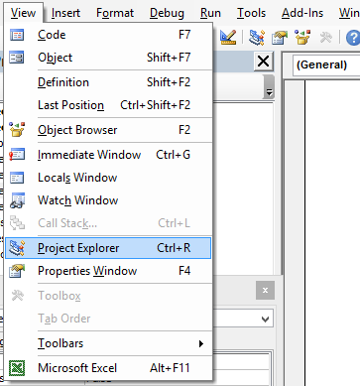
ACTIVATE WINDOWS

